Slide 1
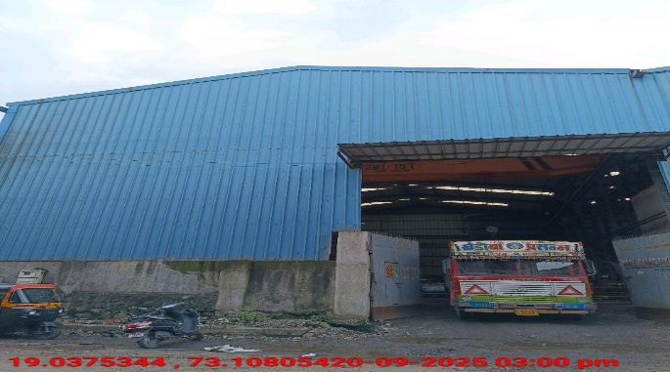
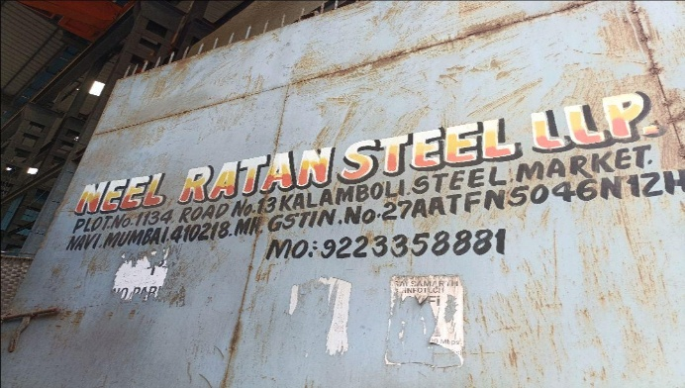
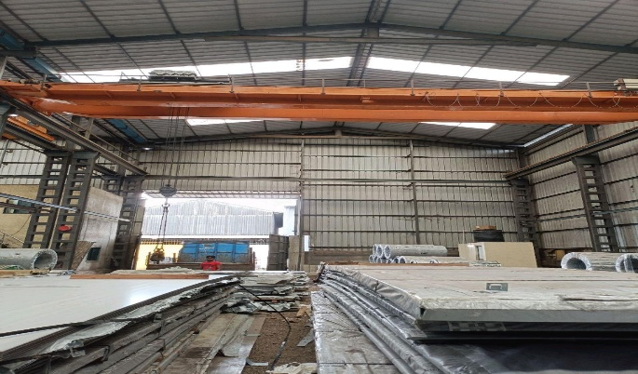
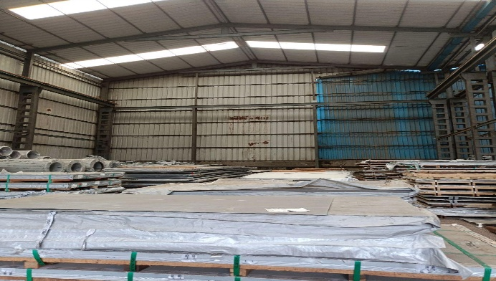
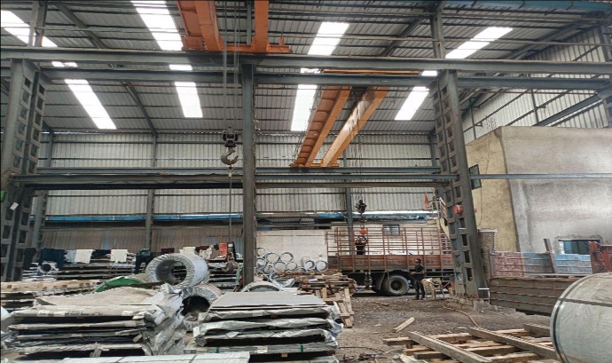
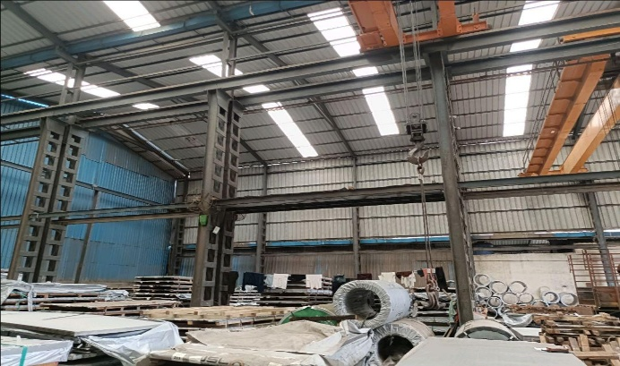
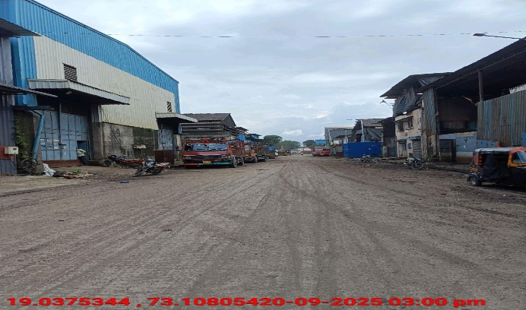
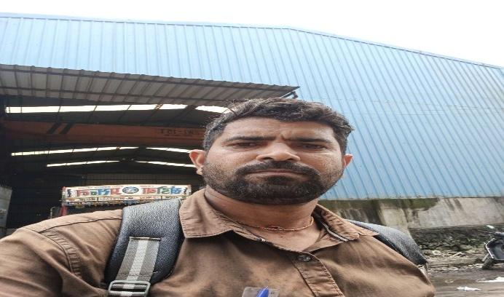
V.S.JADON & CO VALUERS LLP
PHOTOGRAPHS OF PROPERTY OF CUSTOMER: NEEL RATAN STEEL LLP
Site Photo
VSJCVNM-AXIS-RTL-SEP25-22103 Page 1

Slide 2
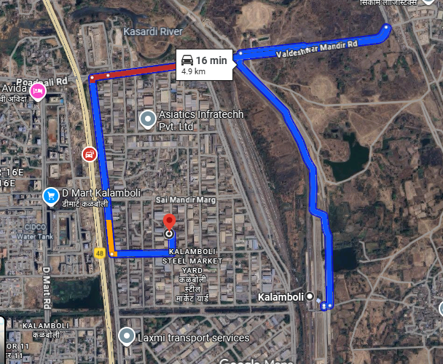
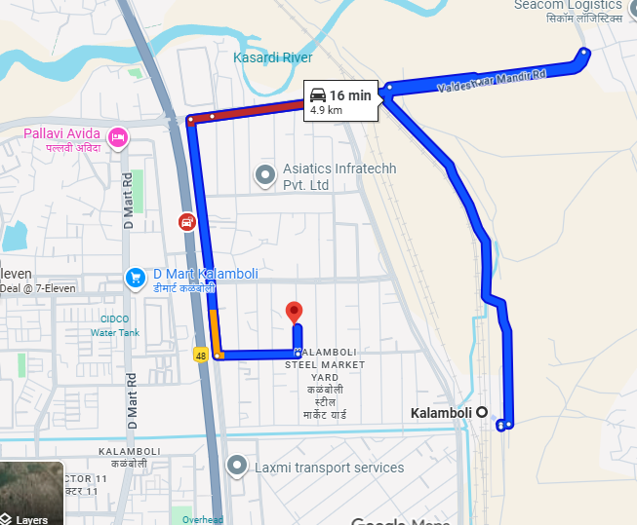
V.S.JADON & CO VALUERS LLP
PHOTOGRAPHS OF PROPERTY OF CUSTOMER: NEEL RATAN STEEL LLP.
Google Map :
VSJCVNM-AXIS-RTL-SEP25-22103 Page 2

Slide 3
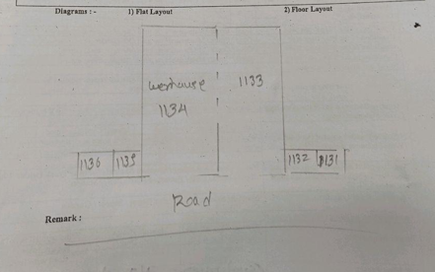
V.S.JADON & CO VALUERS LLP
PHOTOGRAPHS OF PROPERTY OF CUSTOMER NEEL RATAN STEEL LLP
Site layout & Govt Rate :
VSJCVNM-AXIS-RTL-SEP25-22103 Page 3

