Slide 1
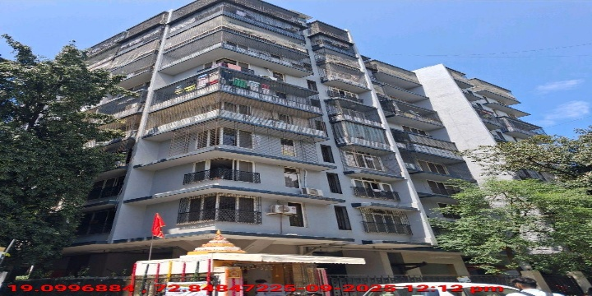
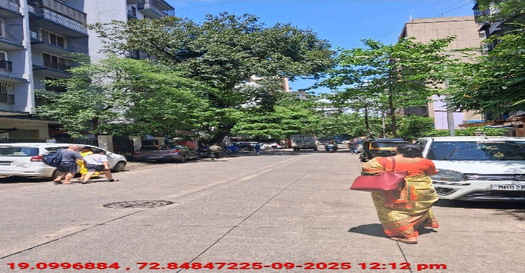
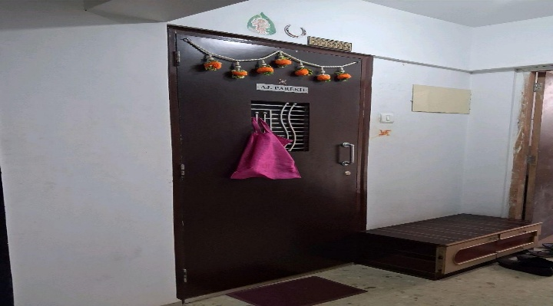
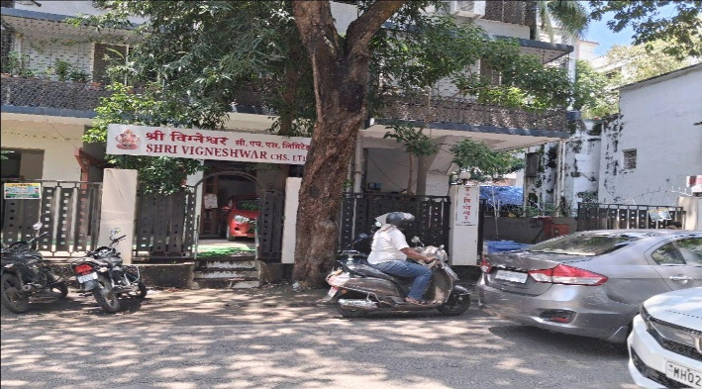
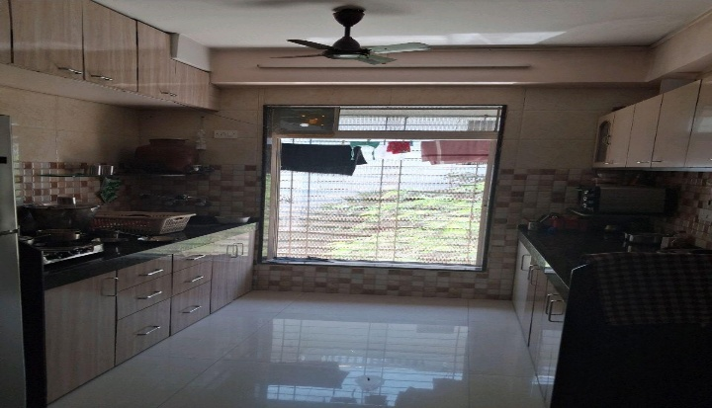
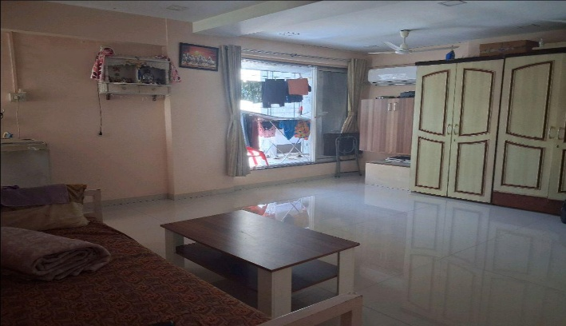
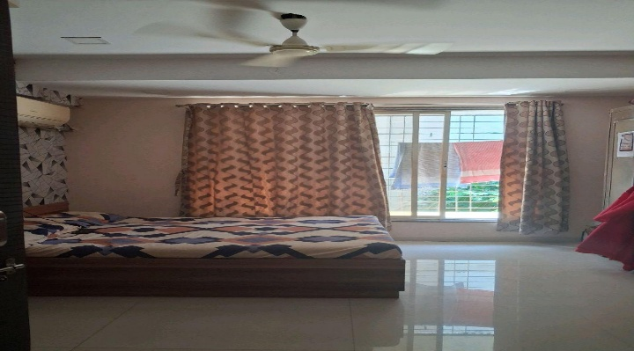
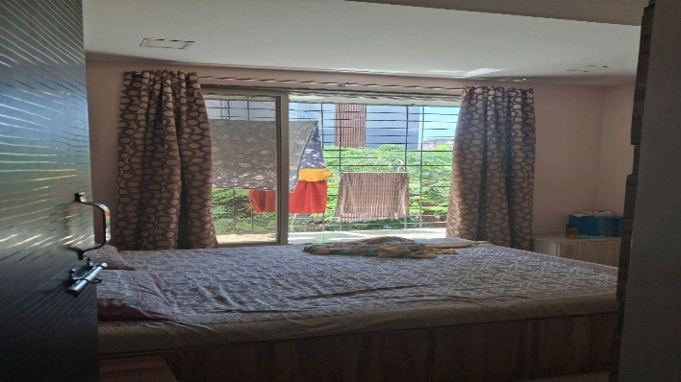
V.S.JADON & CO VALUERS LLP
PHOTOGRAPHS OF PROPERTY OF CUSTOMER: KBA Infrastructure Pvt Ltd
Site Photo
VSJCVNM-RBL-RTL-SEP25-22706 Page 1

Slide 2
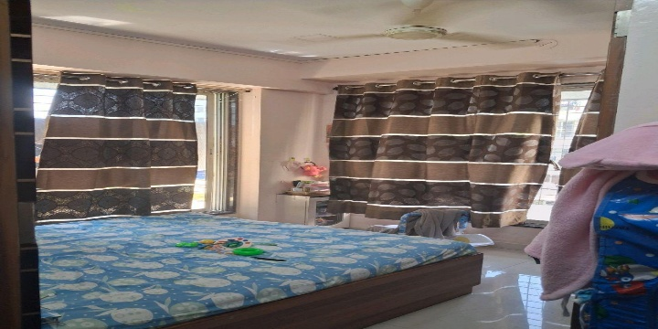
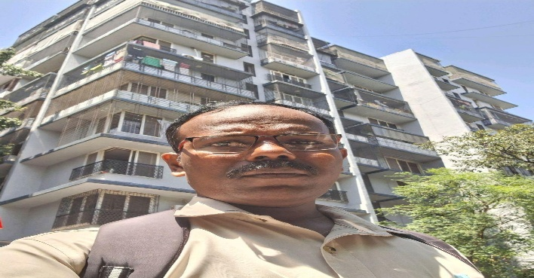
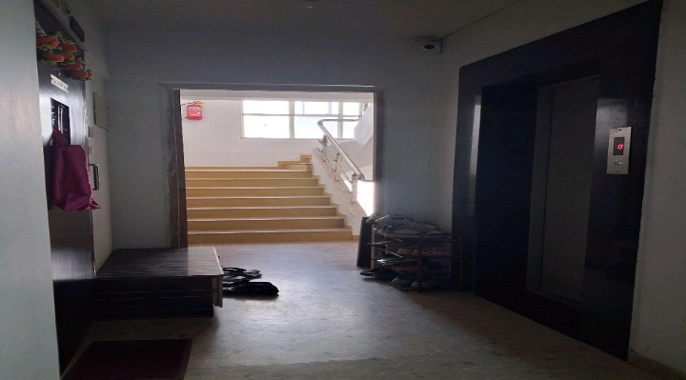
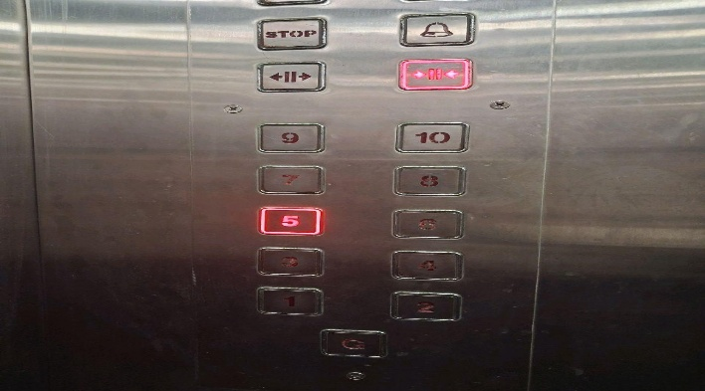
V.S.JADON & CO VALUERS LLP
PHOTOGRAPHS OF PROPERTY OF CUSTOMER: KBA Infrastructure Pvt Ltd
Site Photo
VSJCVNM-RBL-RTL-SEP25-22706 Page 1

Slide 3
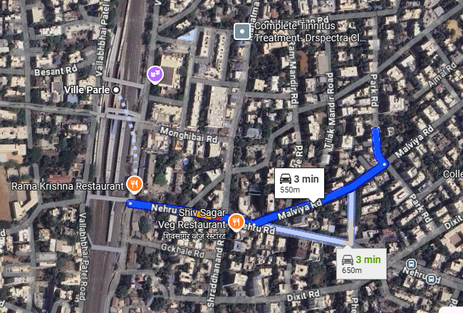
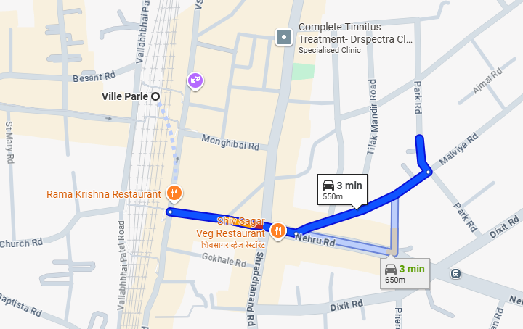
V.S.JADON & CO VALUERS LLP
PHOTOGRAPHS OF PROPERTY OF CUSTOMER: KBA Infrastructure Pvt Ltd
Google Map :
VSJCVNM-RBL-RTL-SEP25-22706 Page 2

Slide 4
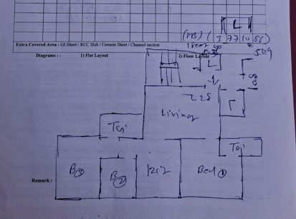
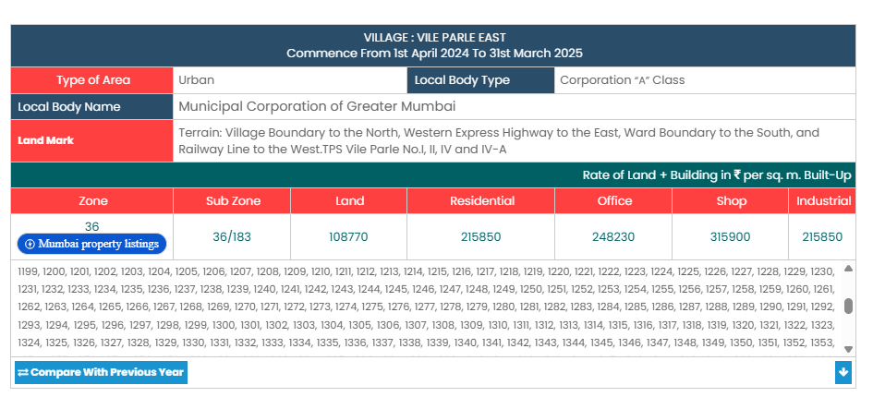
V.S.JADON & CO VALUERS LLP
PHOTOGRAPHS OF PROPERTY OF CUSTOMER: KBA Infrastructure Pvt Ltd
Site Layout :
VSJCVNM-RBL-RTL-SEP25-22706 Page 3

