Slide 1
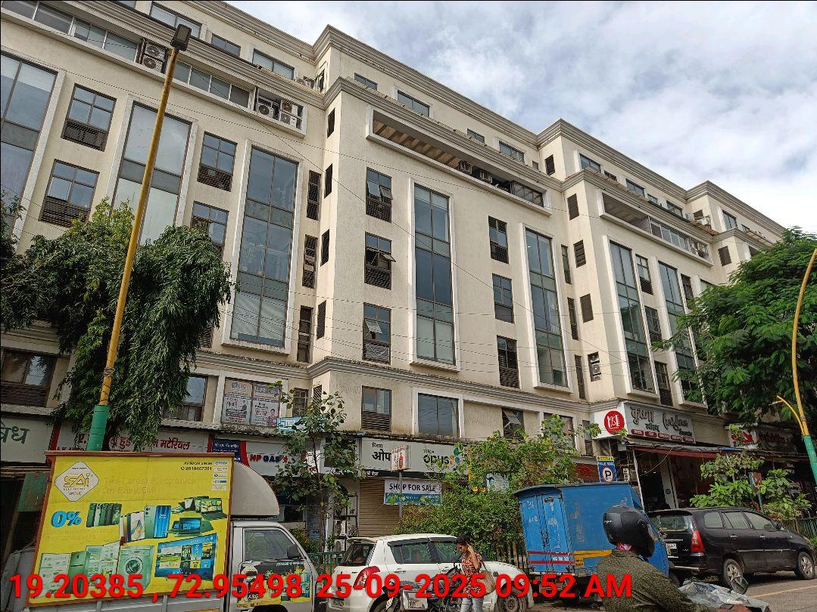
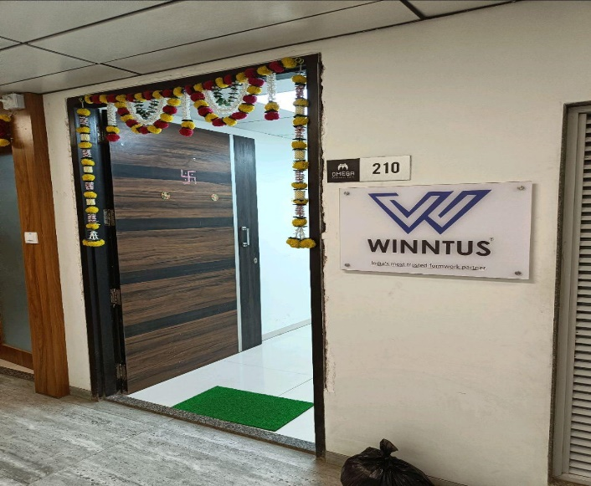
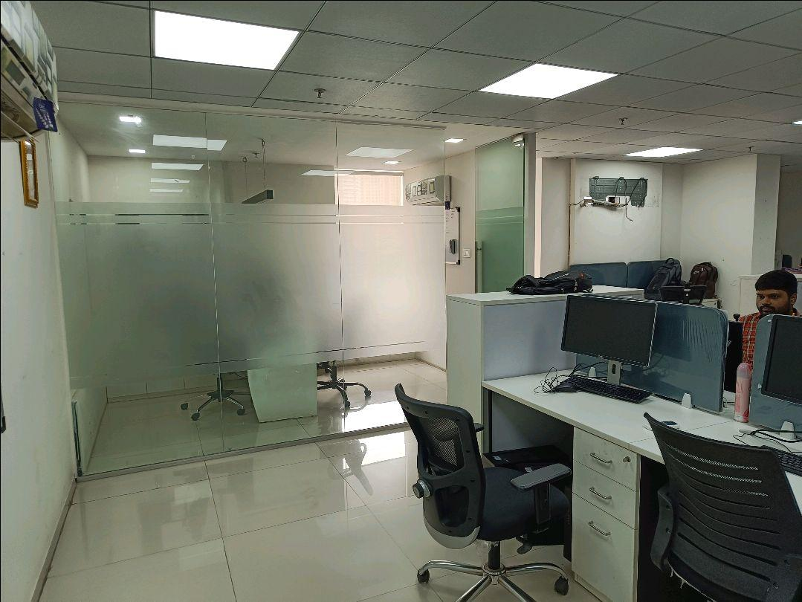
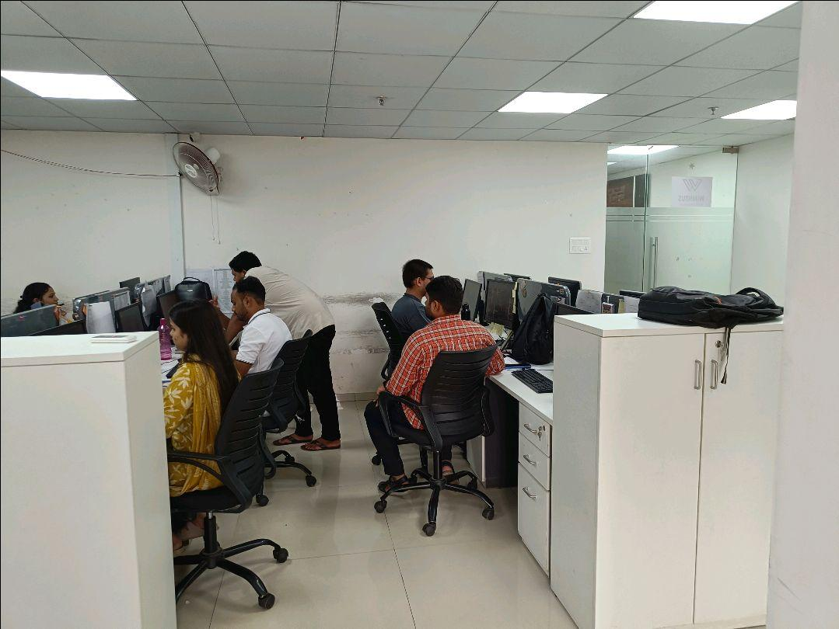
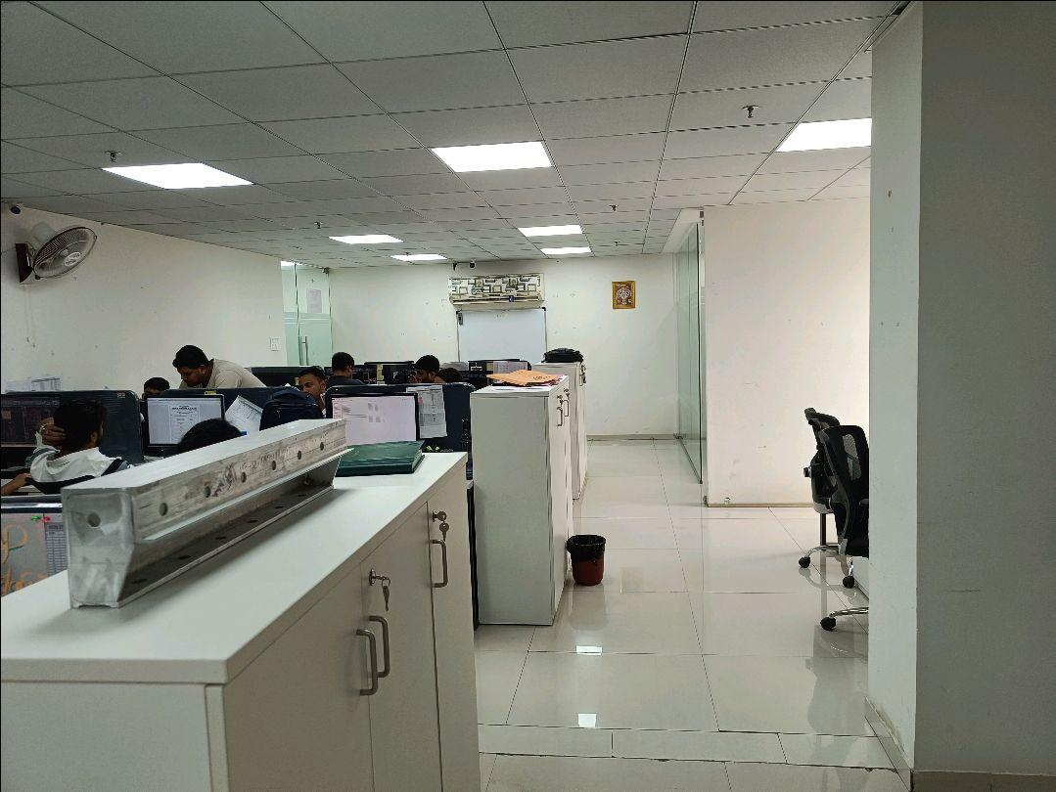
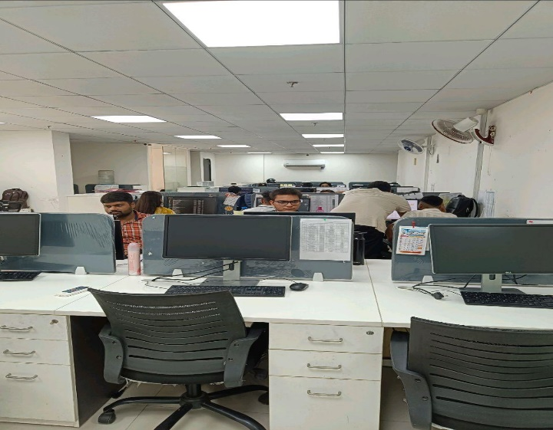
V.S.JADON & CO VALUERS LLP
Site Photo
PHOTOGRAPHS OF PROPERTY OF CUSTOMER: 143DESIGNZ
VSJCVNM-AXIS-RTL-SEP25-22756 Page 1

Slide 2
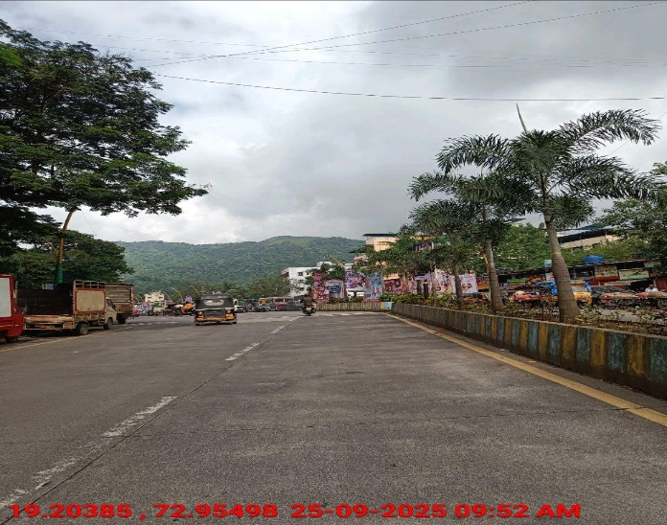

V.S.JADON & CO VALUERS LLP
Site Photo
VSJCVNM-AXIS-RTL-SEP25-22756 Page 2

Slide 3
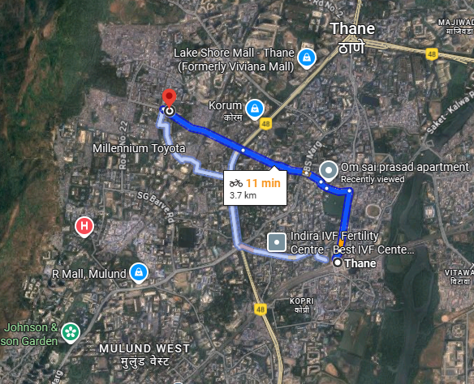
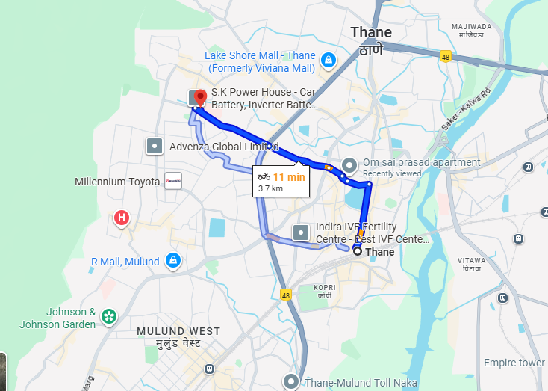
V.S.JADON & CO VALUERS LLP
PHOTOGRAPHS OF PROPERTY OF CUSTOMER: 143DESIGNZ
Google Maps :
VSJCVNM-AXIS-RTL-SEP25-22755 Page 3

Slide 4
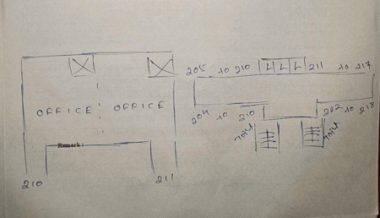
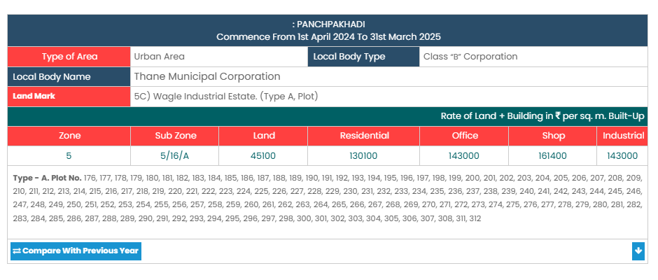
V.S.JADON & CO VALUERS LLP
PHOTOGRAPHS OF PROPERTY OF CUSTOMER: 143DESIGNZ
Site Layout :
VSJCVNM-AXIS-RTL-SEP25-22756 Page 4

