Slide 1
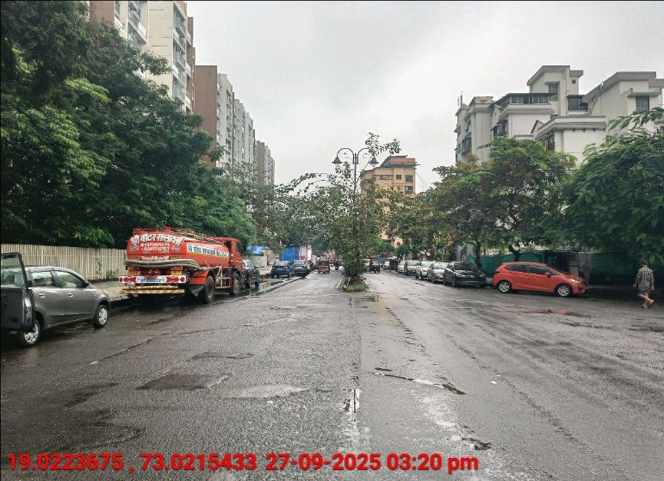
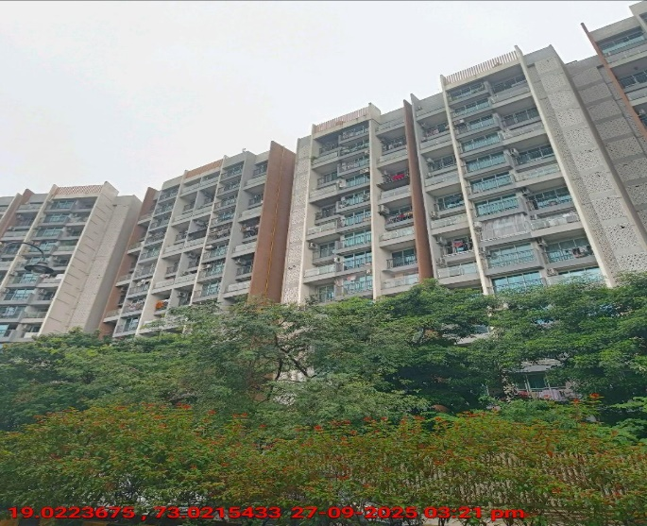
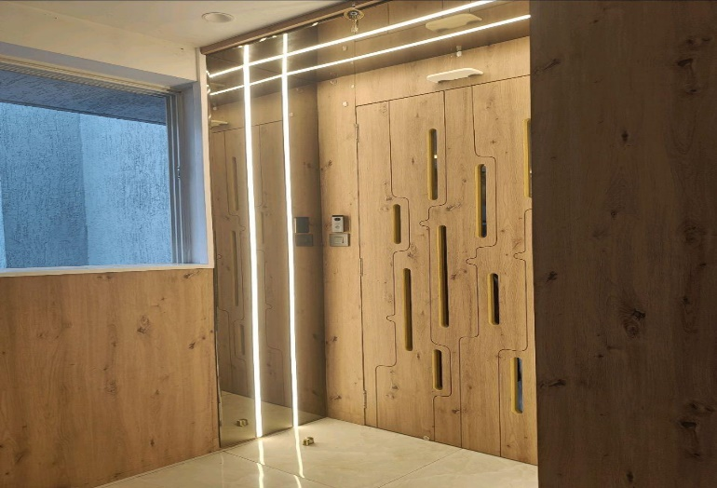
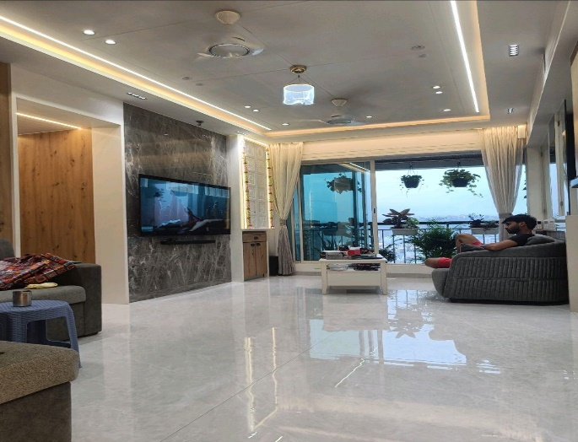
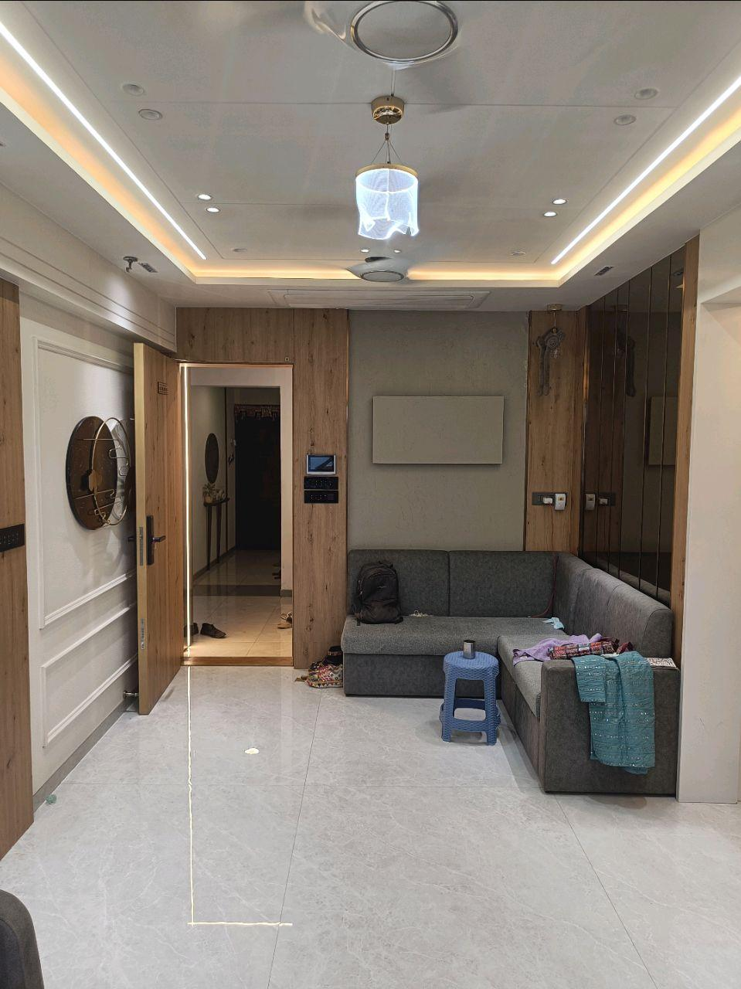
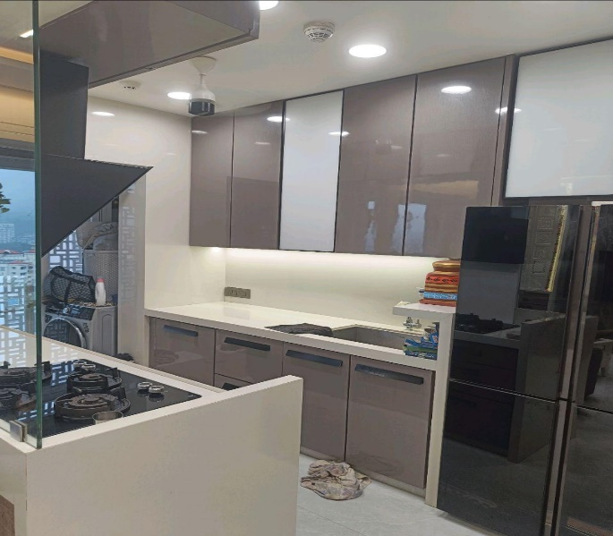
V.S.JADON & CO VALUERS LLP
Site Photo
PHOTOGRAPHS OF PROPERTY OF CUSTOMER: OM SLIVER
VSJCVNM-AXIS-RTL-SEP25-23044 Page 1

Slide 2
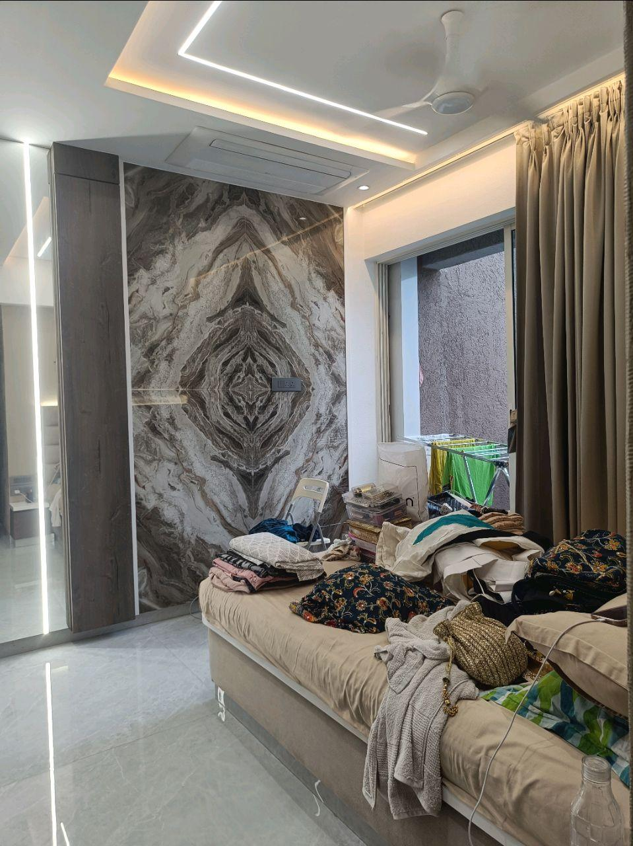
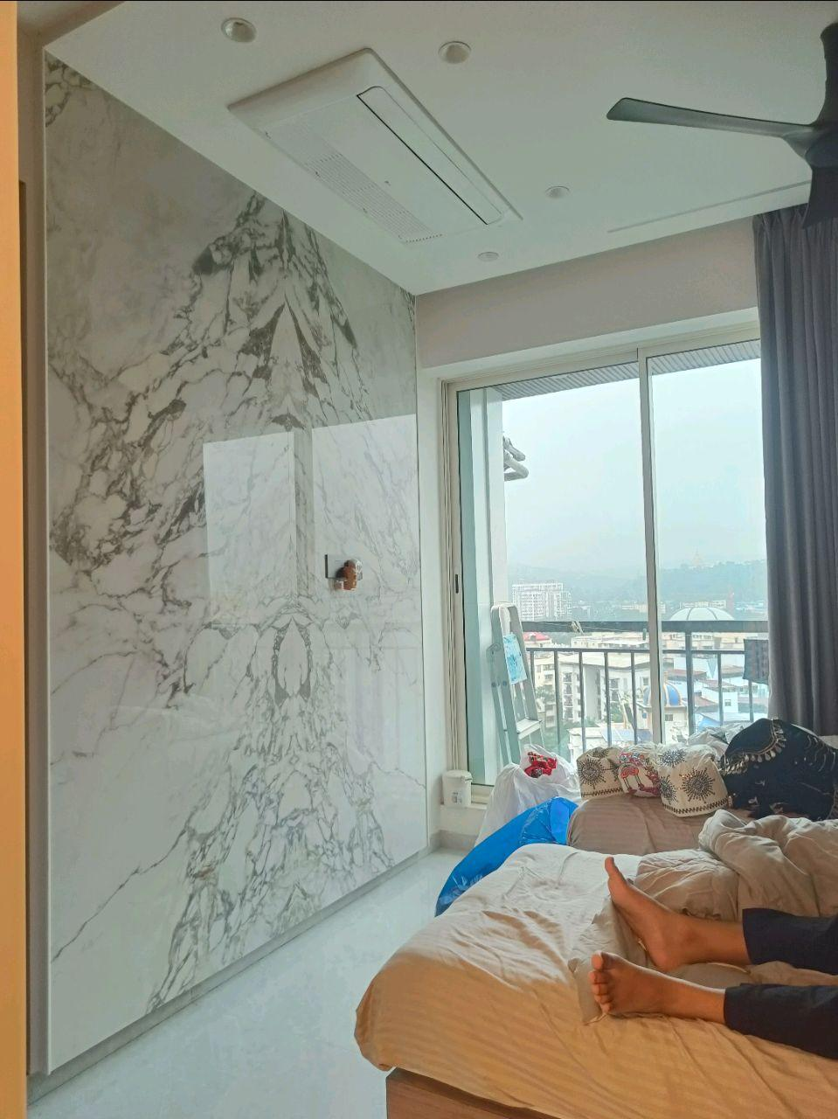
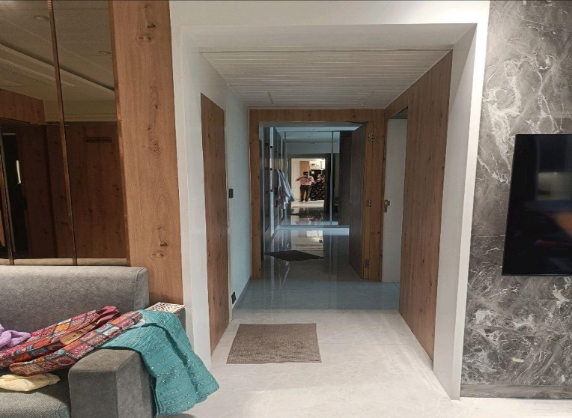
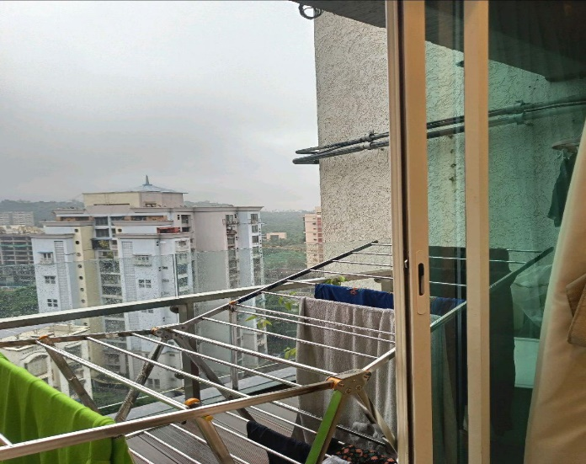

V.S.JADON & CO VALUERS LLP
Site Photo
VSJCVNM-AXIS-RTL-SEP25-23044 Page 2

Slide 3
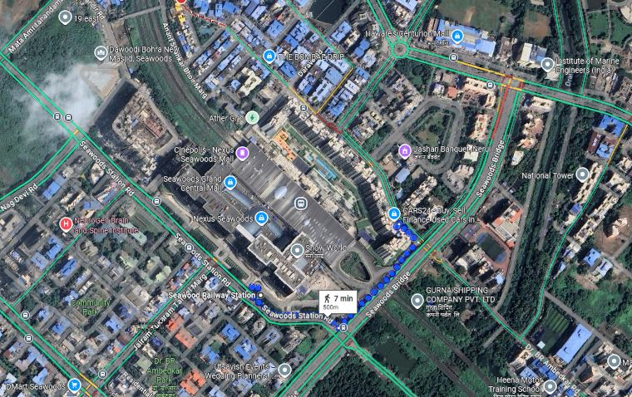
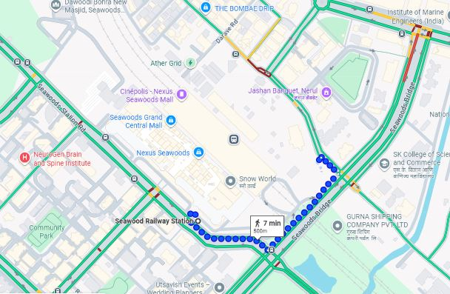
V.S.JADON & CO VALUERS LLP
PHOTOGRAPHS OF PROPERTY OF CUSTOMER: OM SLIVER
Google Maps :
VSJCVNM-AXIS-RTL-SEP25-23044 Page 3

Slide 4
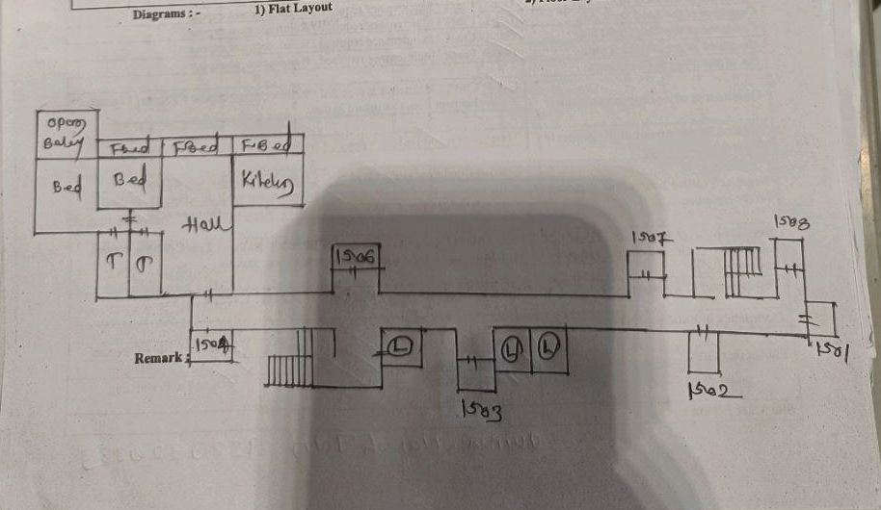
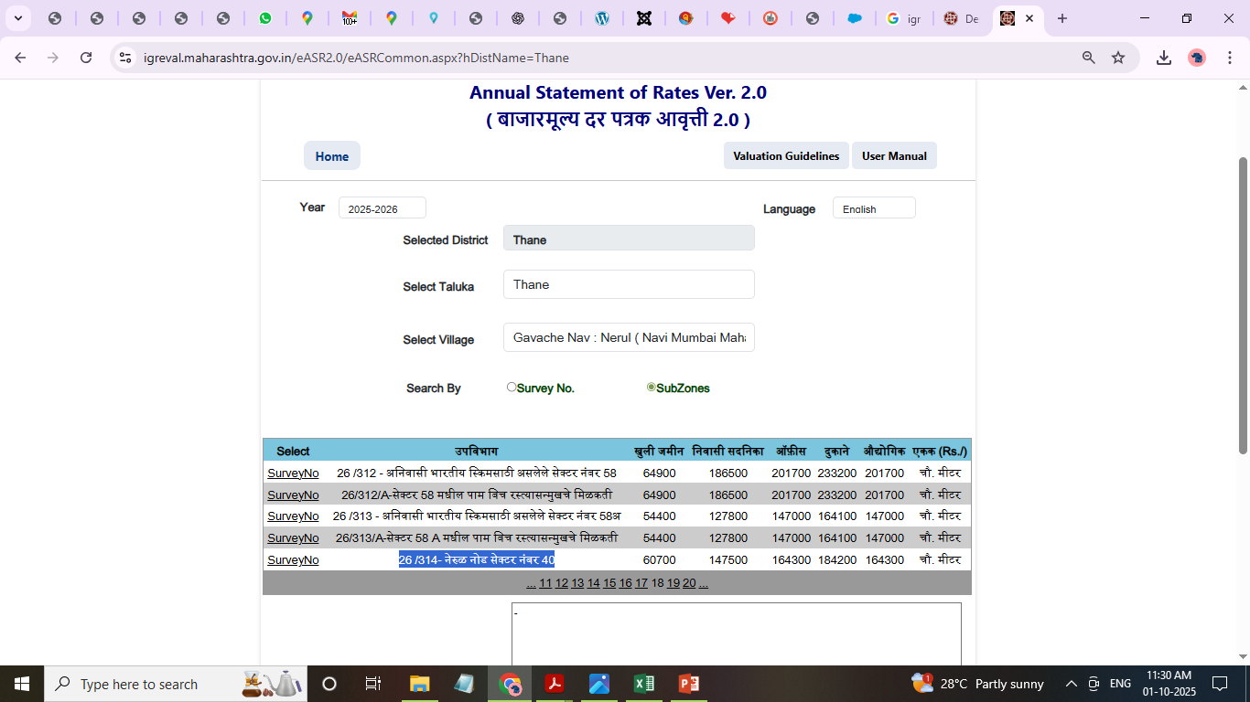
V.S.JADON & CO VALUERS LLP
PHOTOGRAPHS OF PROPERTY OF CUSTOMER: OM SLIVER
Site Layout :
VSJCVNM-AXIS-RTL-SEP25-23044 Page 4

