Slide 1
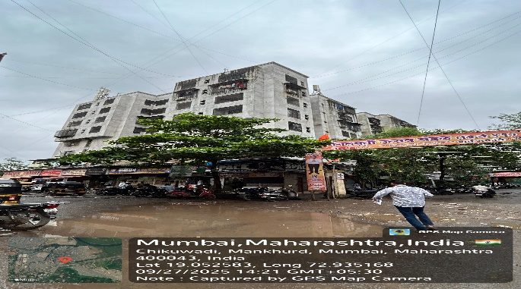
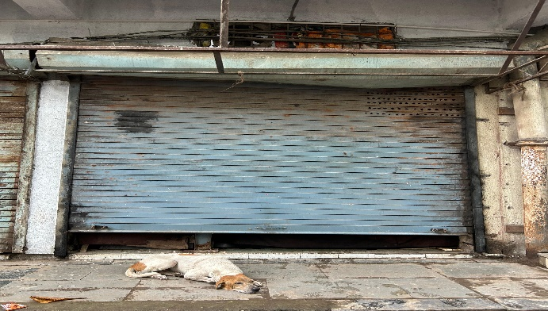
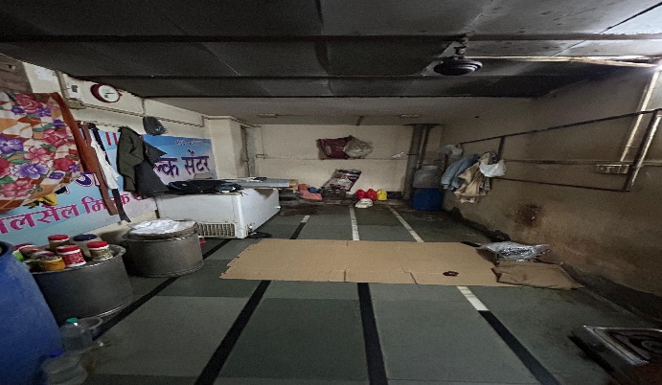
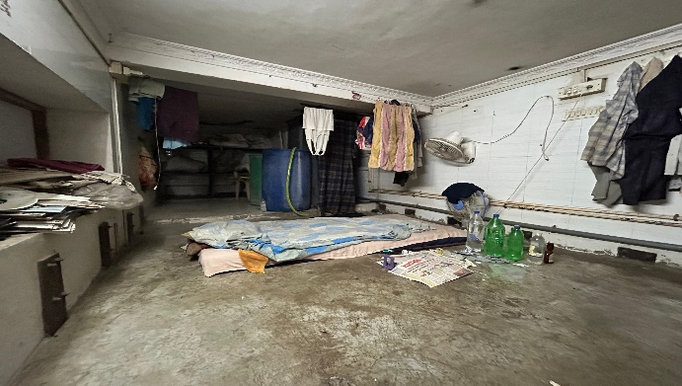
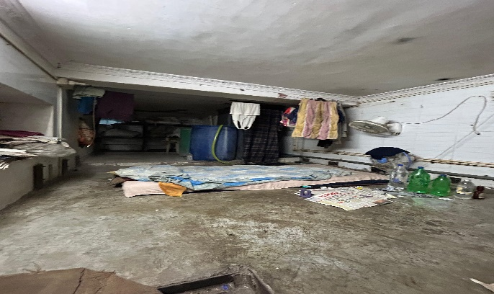
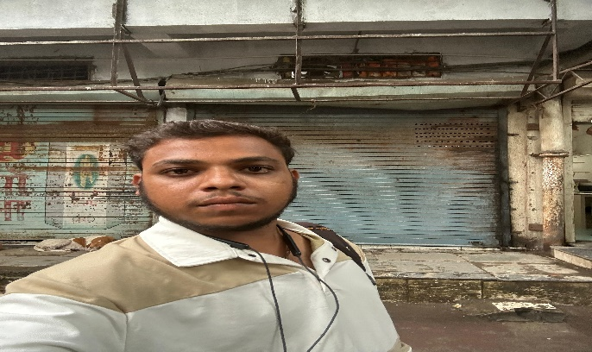
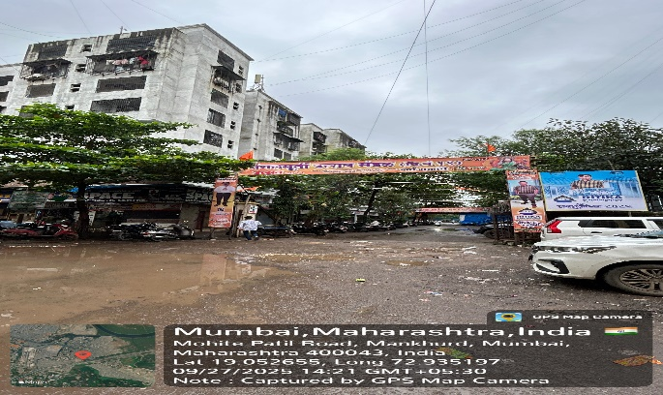
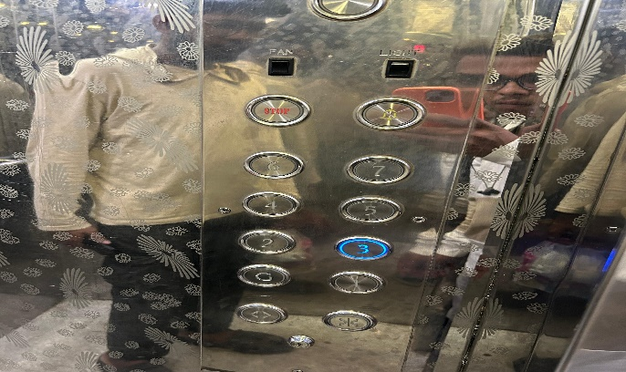
V.S.JADON & CO VALUERS LLP
PHOTOGRAPHS OF PROPERTY OF CUSTOMER: Laxmi Narayan Dairy
Site Photo
VSJCVNM-AXIS-RTL-SEP25-23117 Page 1

Slide 2
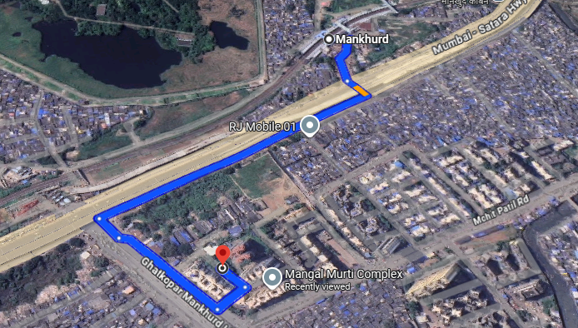
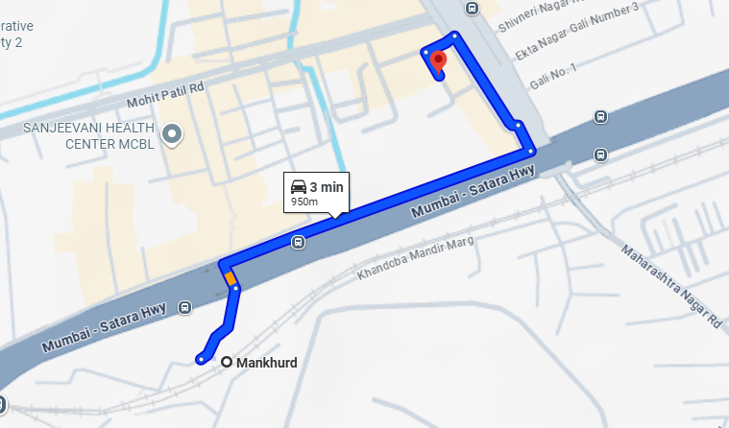
V.S.JADON & CO VALUERS LLP
PHOTOGRAPHS OF PROPERTY OF CUSTOMER: Laxmi Narayan Dairy
Google Map :
VSJCVNM-AXIS-RTL-SEP25-23117 Page 2

Slide 3
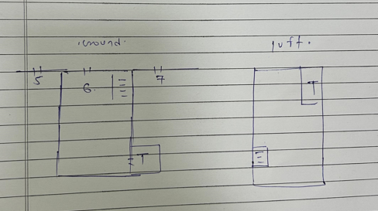
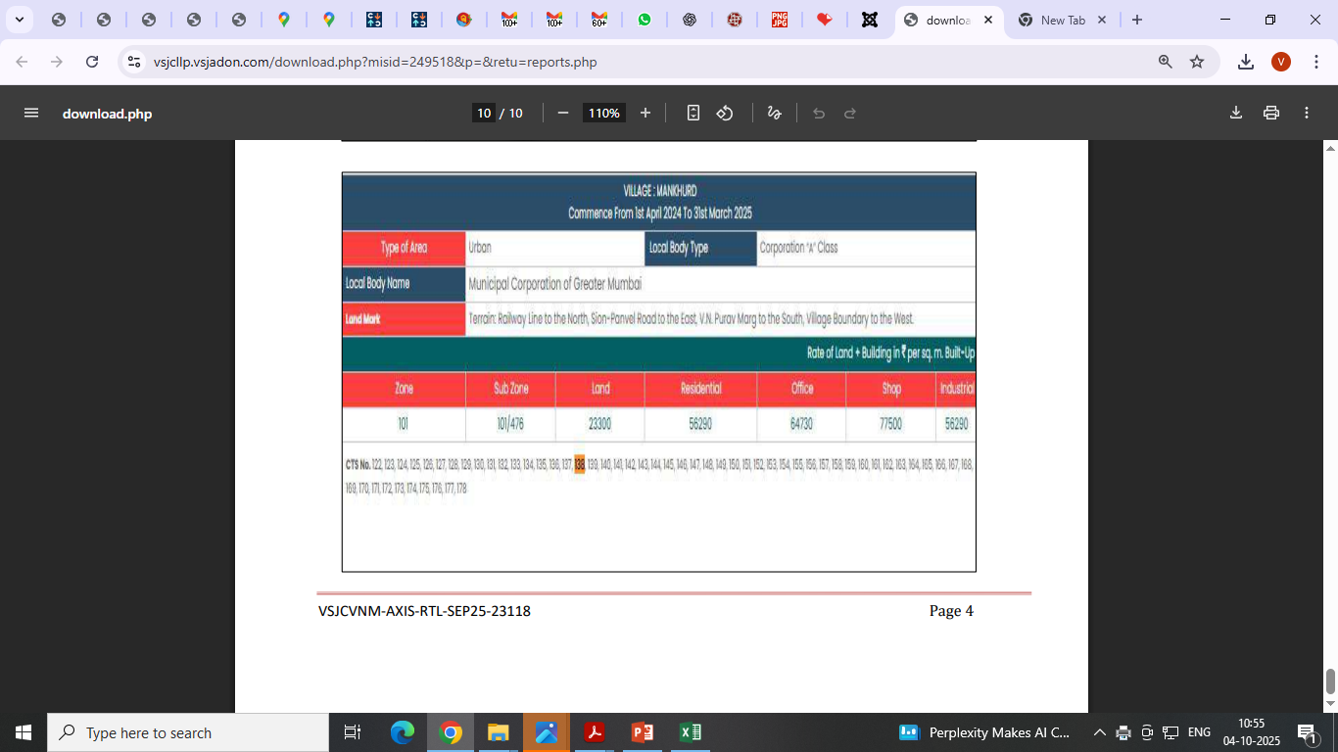
V.S.JADON & CO VALUERS LLP
PHOTOGRAPHS OF PROPERTY OF CUSTOMER Laxmi Narayan Dairy
Site layout :
VSJCVNM-AXIS-RTL-SEP25-23117 Page 3

