Slide 1
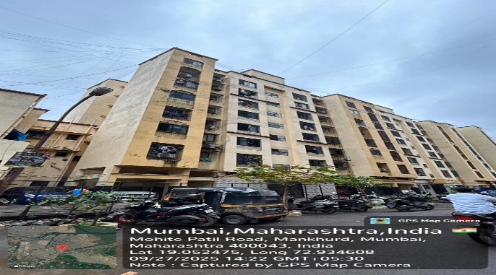
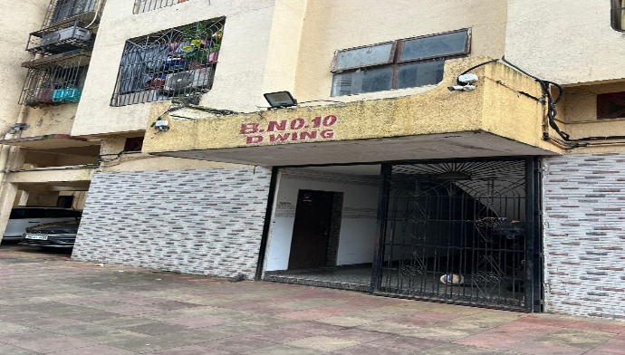
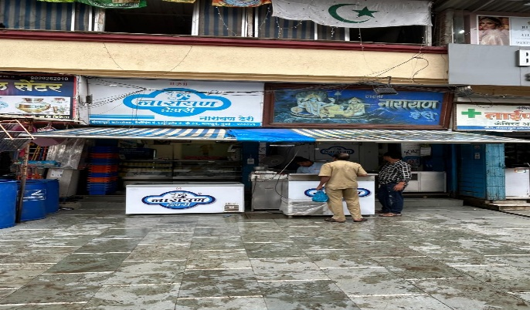
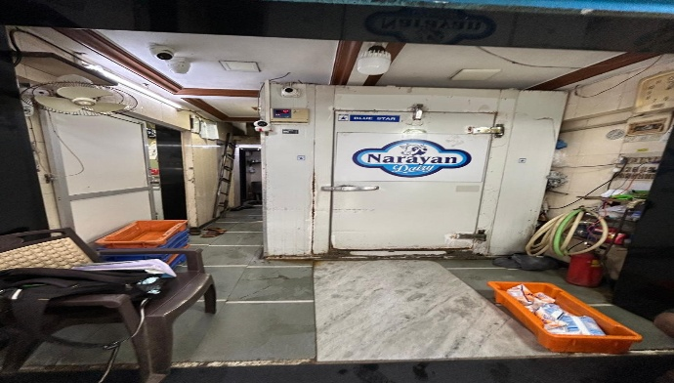
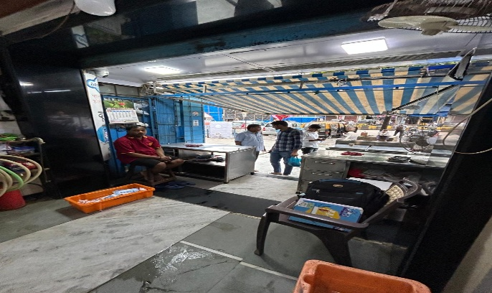
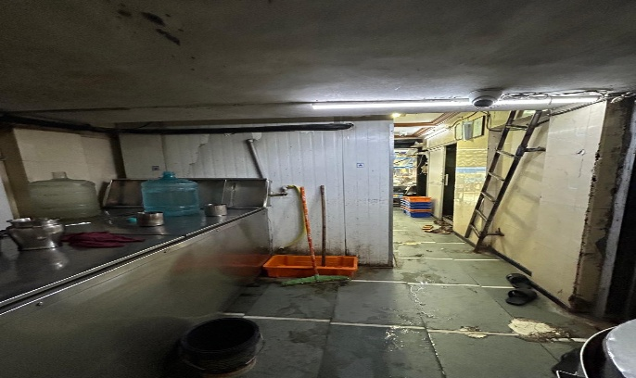
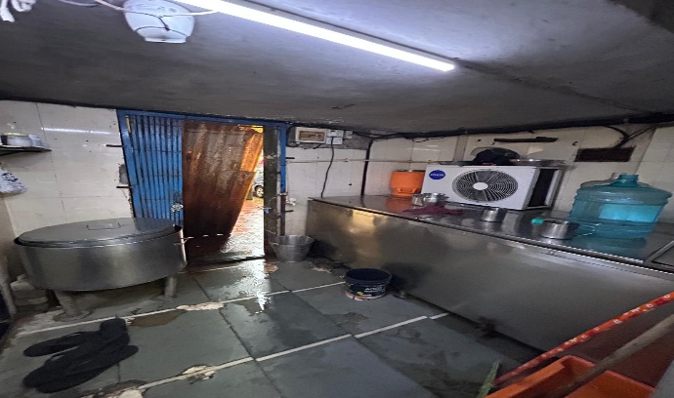
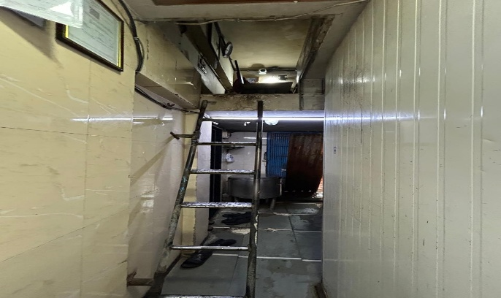
V.S.JADON & CO VALUERS LLP
PHOTOGRAPHS OF PROPERTY OF CUSTOMER: laxmi Narayan Dairy
Site Photo
VSJCVNM-AXIS-RTL-SEP25-23118
Page 1

Slide 2
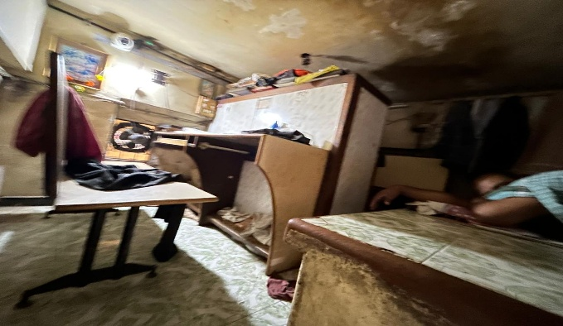
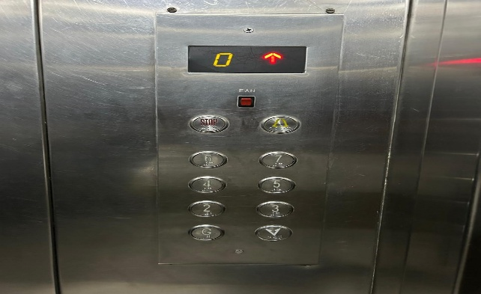
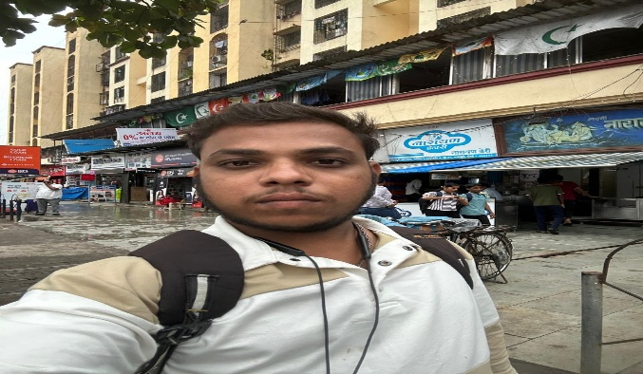
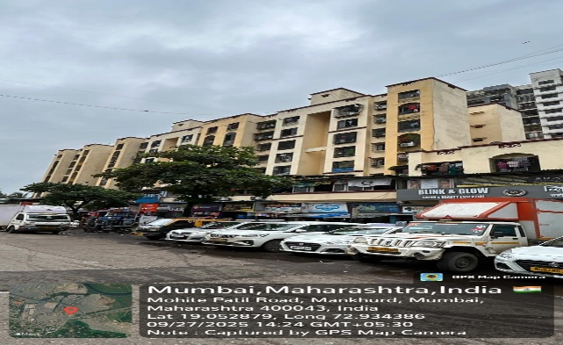
V.S.JADON & CO VALUERS LLP
PHOTOGRAPHS OF PROPERTY OF CUSTOMER: laxmi Narayan Dairy
Site Photo
VSJCVNM-AXIS-RTL-SEP25-23118 Page 2

Slide 3
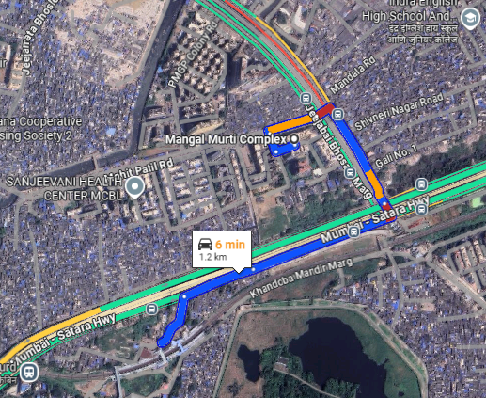
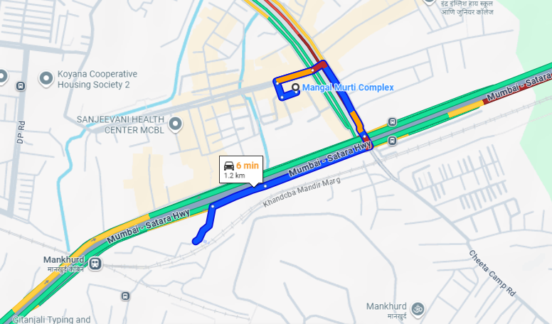
V.S.JADON & CO VALUERS LLP
PHOTOGRAPHS OF PROPERTY OF CUSTOMER: laxmi Narayan Dairy
Google Map :
VSJCVNM-AXIS-RTL-SEP25-23118 Page 3

Slide 4
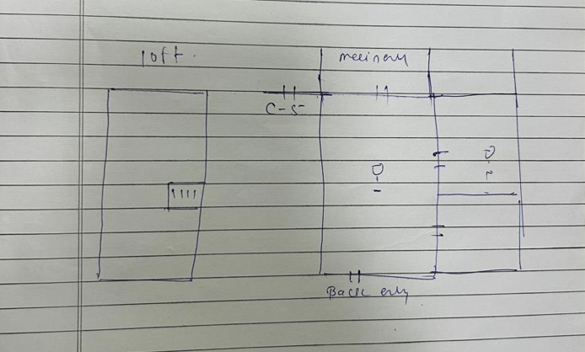
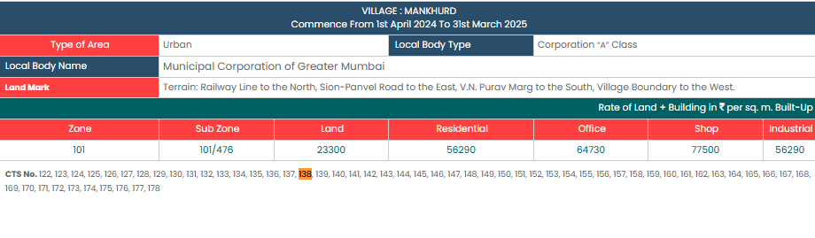
V.S.JADON & CO VALUERS LLP
PHOTOGRAPHS OF PROPERTY OF CUSTOMER laxmi Narayan Dairy
Site layout & Govt Rate :
VSJCVNM-AXIS-RTL-SEP25-23118 Page 4

