Slide 1
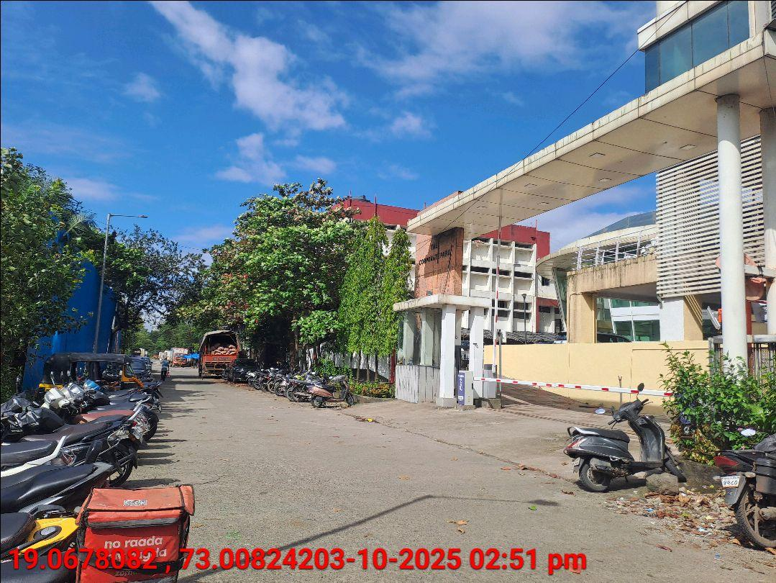
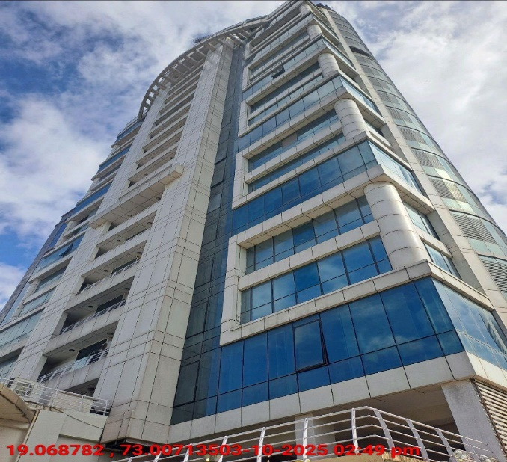
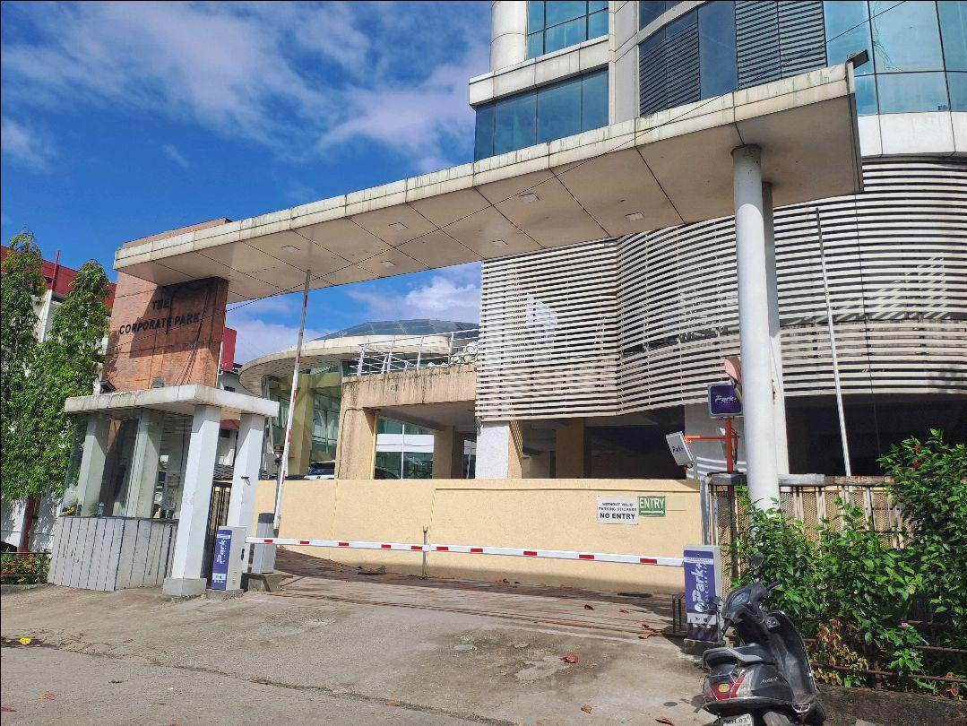
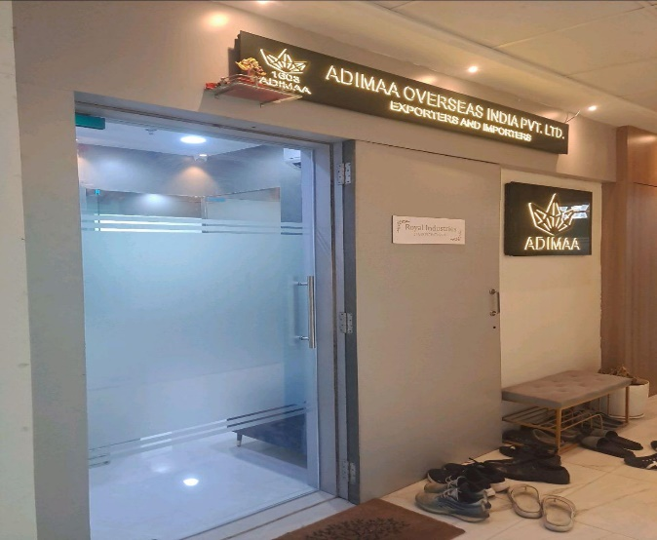
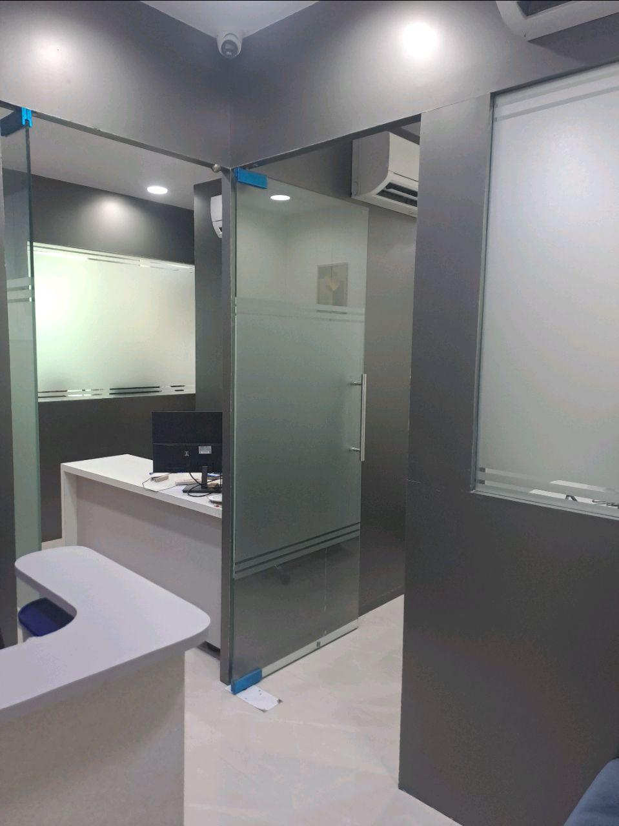
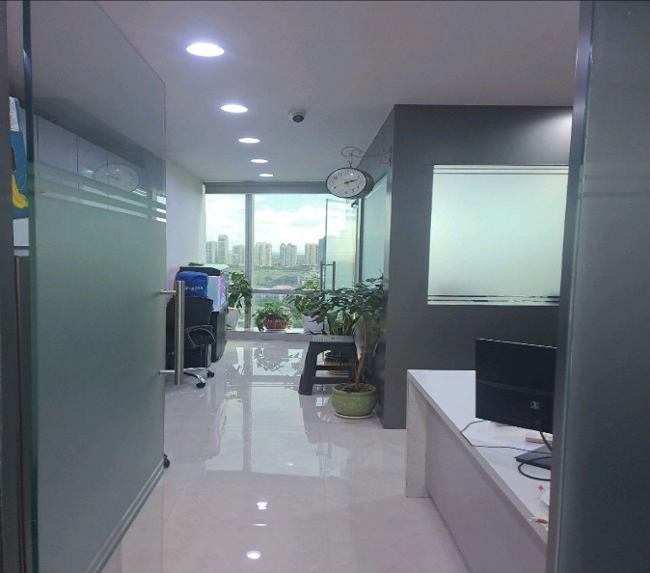
V.S.JADON & CO VALUERS LLP
Site Photo
PHOTOGRAPHS OF PROPERTY OF CUSTOMER: Chevas Imports Exports Pvt Ltd
VSJCVNM-AXIS-RTL-OCT25-23510 Page 1

Slide 2
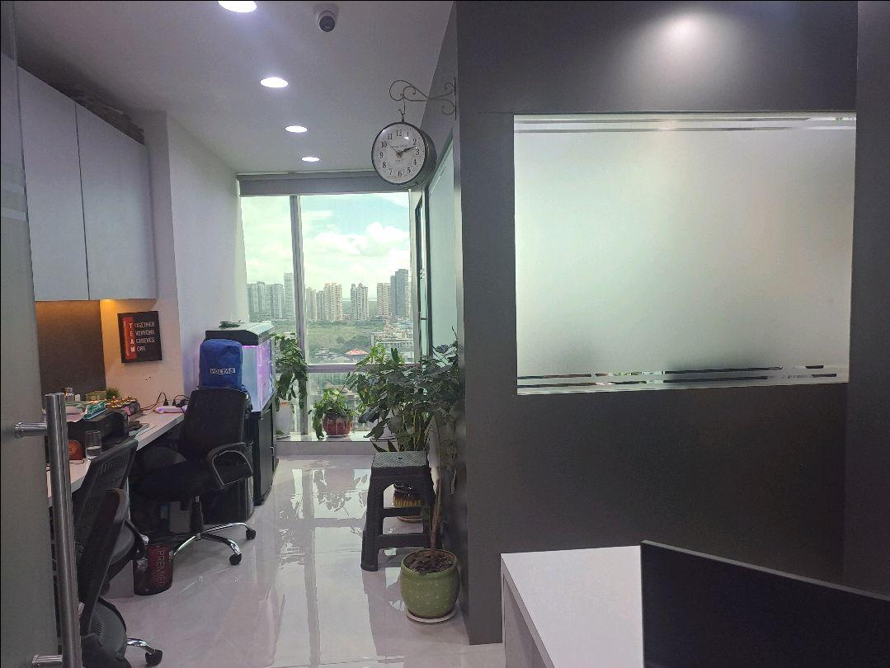
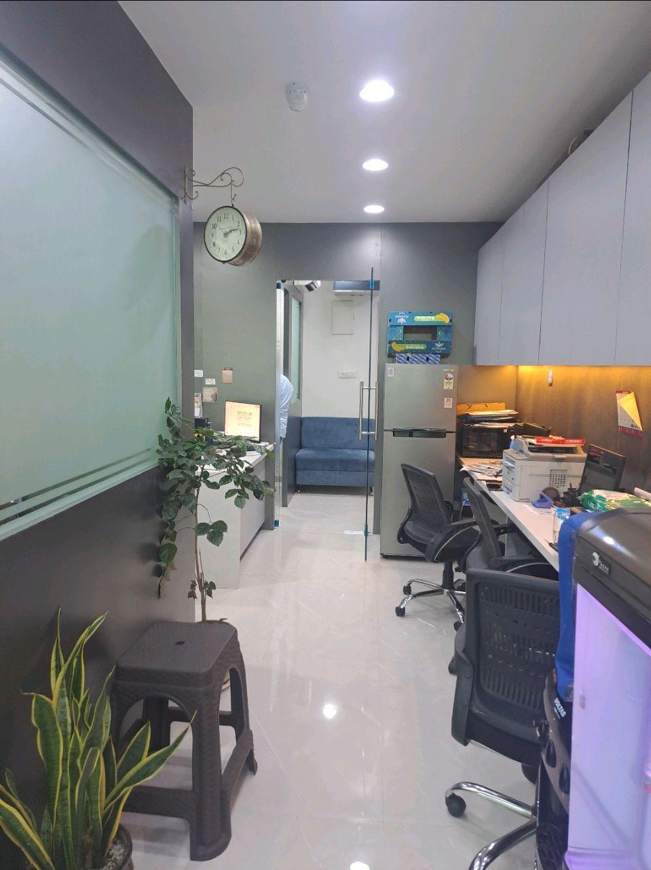

V.S.JADON & CO VALUERS LLP
Site Photo
VSJCVNM-AXIS-RTL-OCT25-23510 Page 2

Slide 3
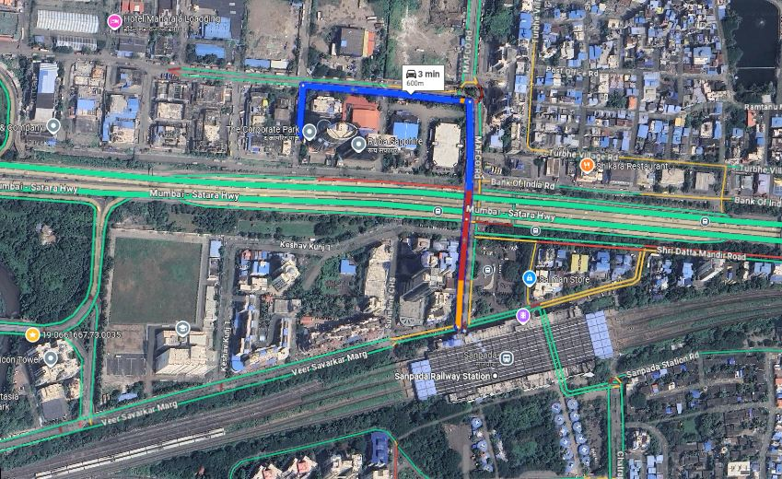
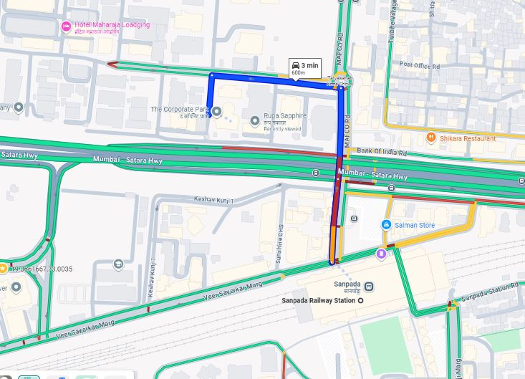
V.S.JADON & CO VALUERS LLP
PHOTOGRAPHS OF PROPERTY OF CUSTOMER: Chevas Imports Exports Pvt Ltd
Google Maps :
VSJCVNM-AXIS-RTL-OCT25-23510 Page 3

Slide 4
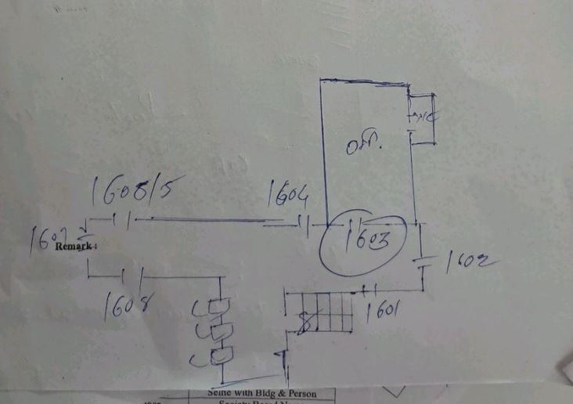
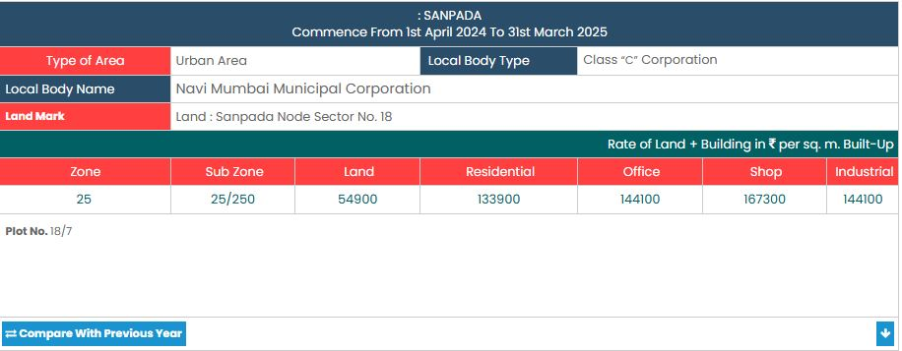
V.S.JADON & CO VALUERS LLP
PHOTOGRAPHS OF PROPERTY OF CUSTOMER: Chevas Imports Exports Pvt Ltd
Site Layout :
VSJCVNM-AXIS-RTL-OCT25-23510 Page 4

