Slide 1
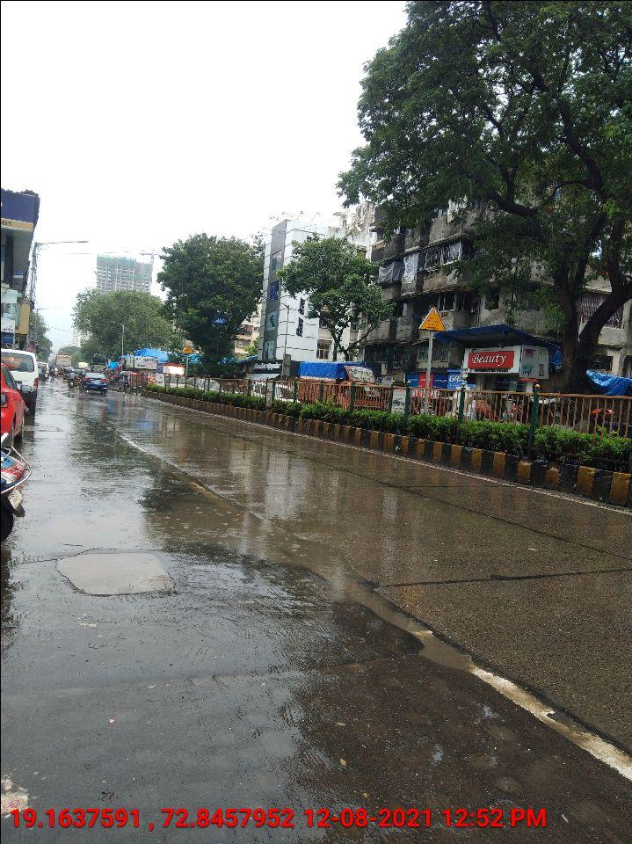
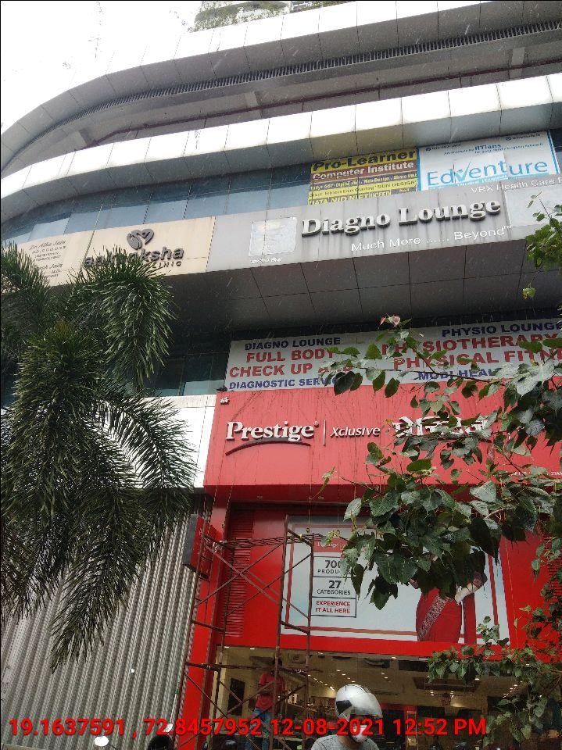
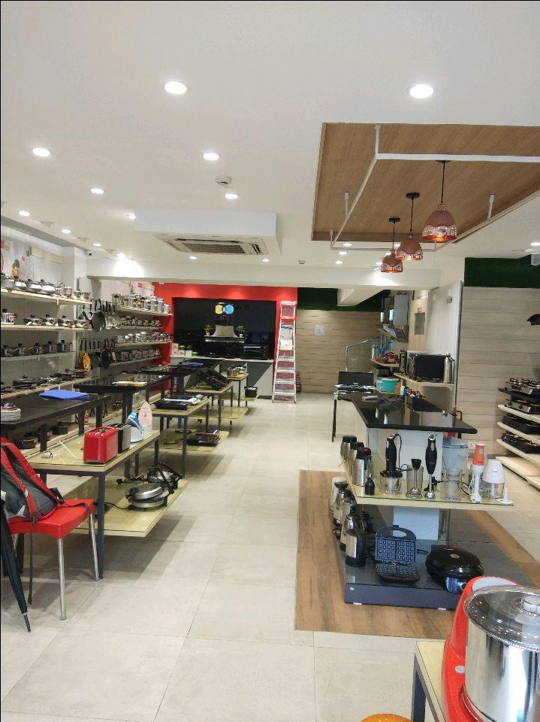
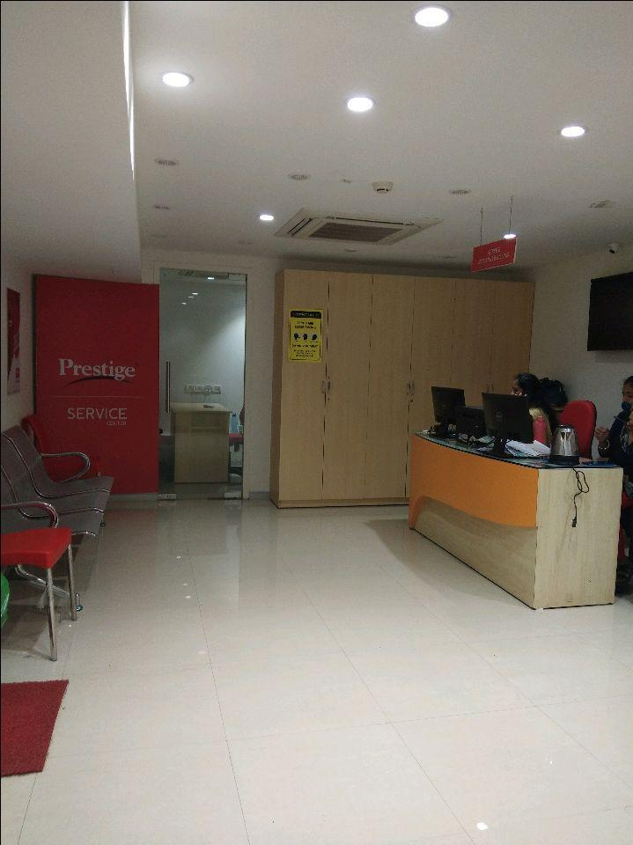
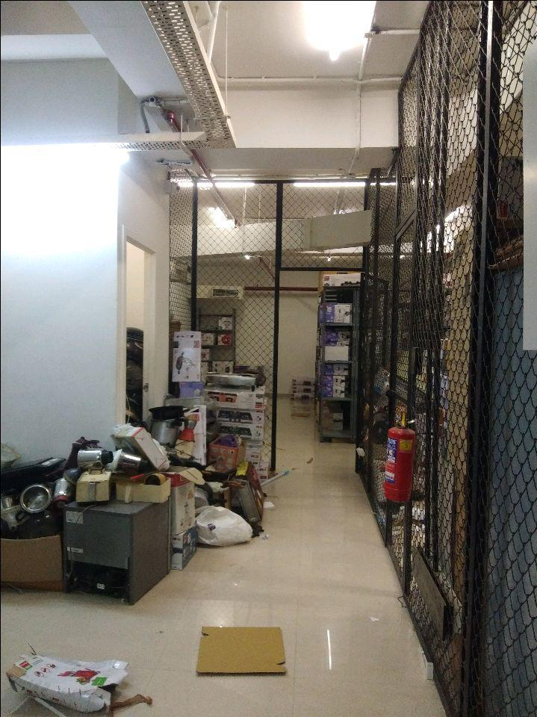
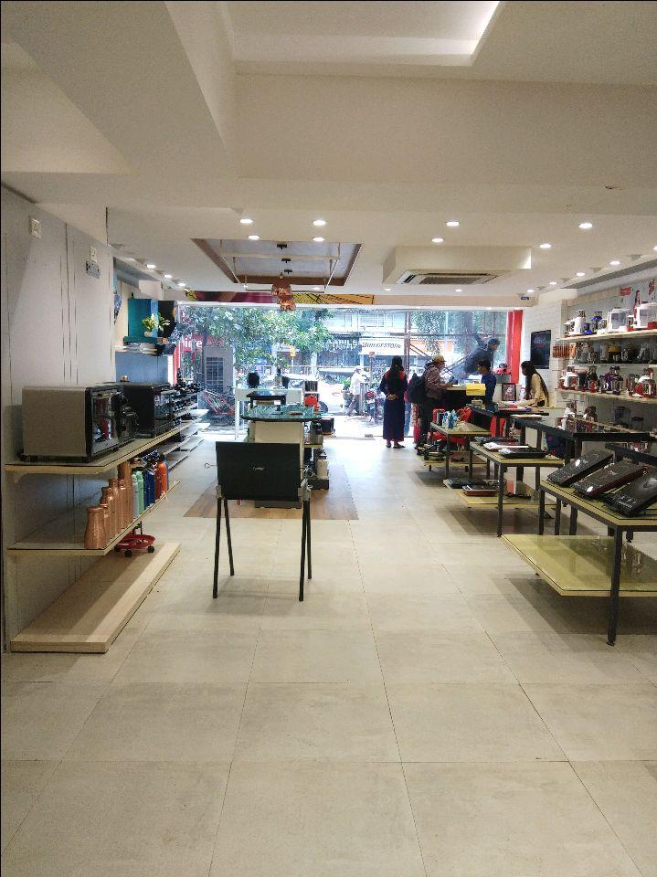
V.S.JADON & CO VALUERS LLP
PHOTOGRAPHS OF PROPERTY OF CUSTOMER: Sameer Desai
VSJCVNM-AXIS-RTL-AUG21-13316 Page 1

Slide 2
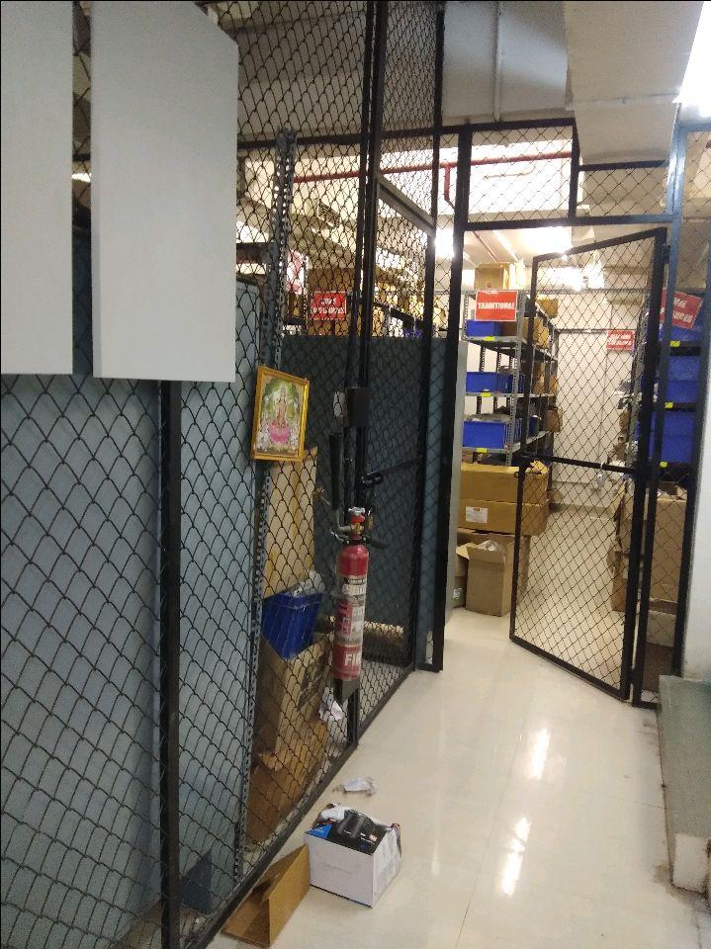
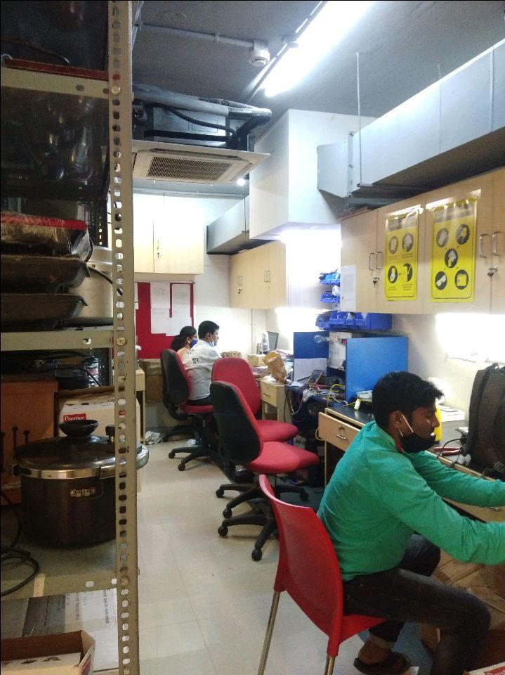
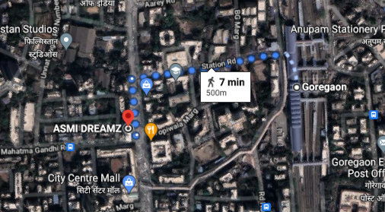
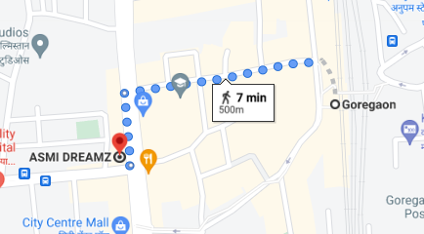
V.S.JADON & CO VALUERS LLP
PHOTOGRAPHS OF PROPERTY OF CUSTOMER: Sameer Desai
GOOGLE LOCATIONS :
VSJCVNM-AXIS-RTL-AUG21-13316 Page 2

